Slide 1
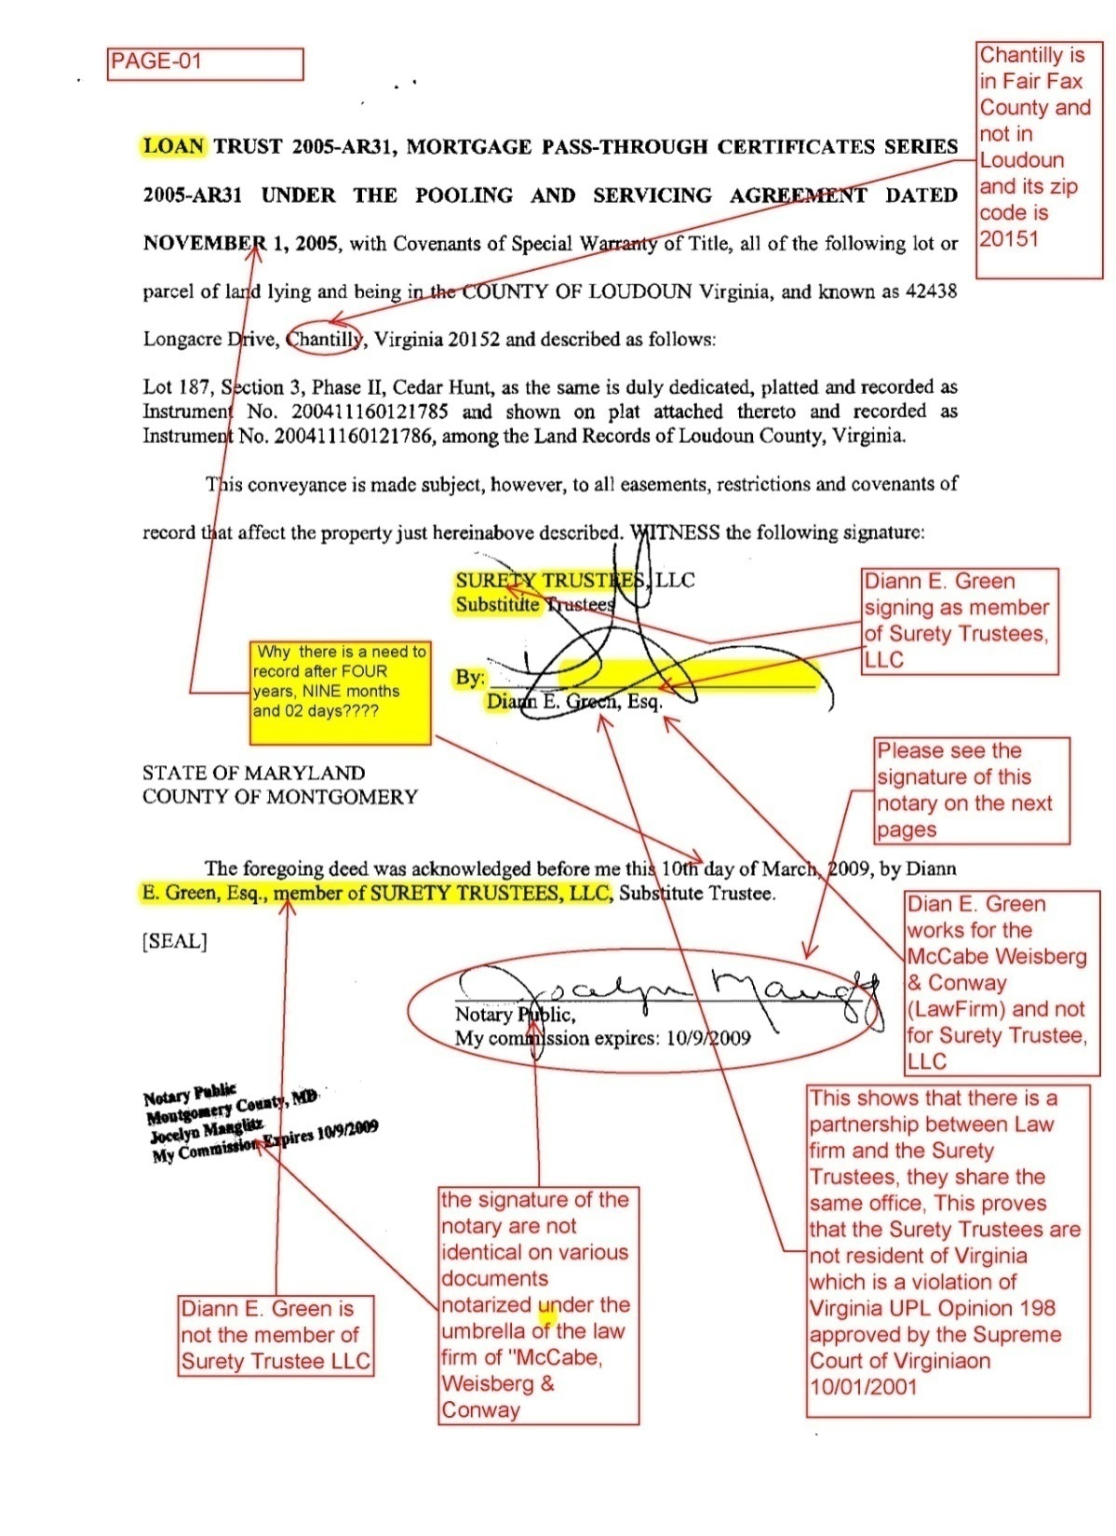
FRAUD UPON COURT
BY A LAW FIRM
Falsification
Hiding Facts
Foreclosure Transmittal letter
Initiating Foreclosure
In the name of wrong Party
Attorney Signining as member of Trustee (Partnership)
Transferring Title to the Undisclosed entities
Notary’s Misconduct
Fictitious signatures

Slide 2
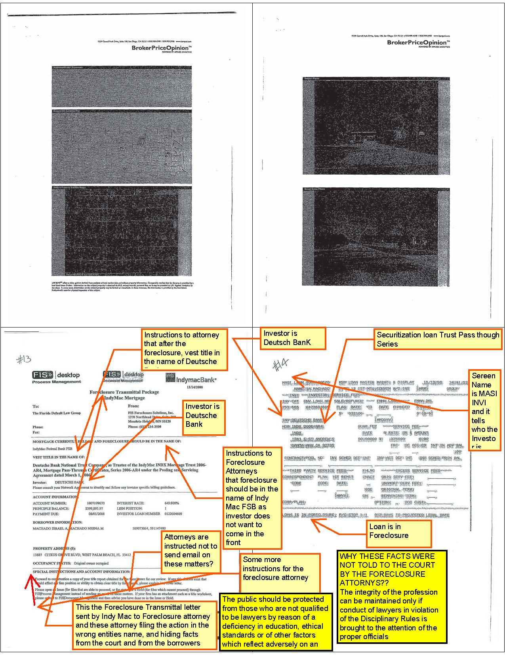
F/Closure Transmittal
Letter
Instructions
Who is servicer
Who is M/servicer
Who is investor (hidden/undisclosed)
F/Closure in the name of WHO?
Falsification Before Court
Fraud Upon Court
F/Closure initiated in the name of Wrong Party?
After F/Closure title Vest to (Undisclosed)?
Transfer How????

Slide 3
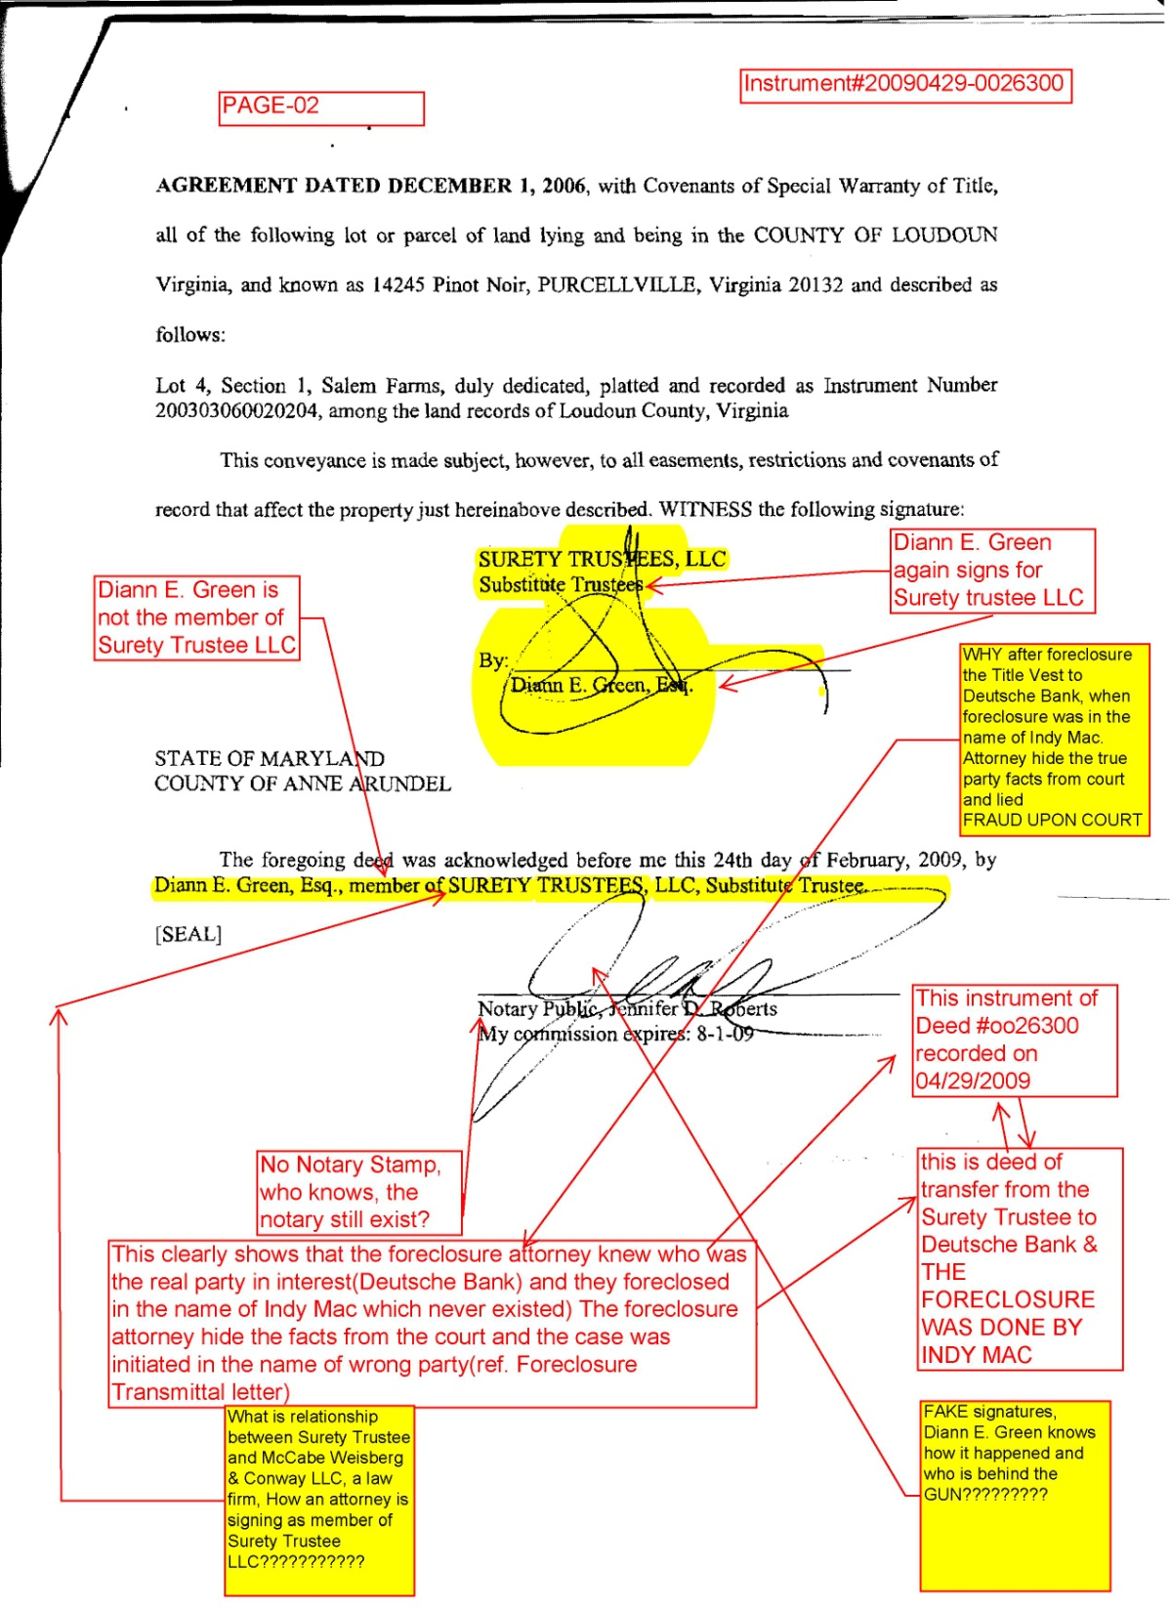
HOW FRAUD WAS DONE
1.Involvement of Law Firm
2.F/Closure attorney signing as member of substitute Trustee???
3.Notary Misconduct
4. Fake Signatures
5. Why after F/Closure Title Vest to Deutsche Bank( Undisclosed) when F/Closure was initiated in the name of Indy Mac??????
6.No Notary Stamp
7.Instrument#20090429-0026300 was recorded by a law Firm of Maryland (McCabe Weisberg& Conway, LLC
8. Ms. Diann E. Green Esq. works for this law Firm.

Slide 4
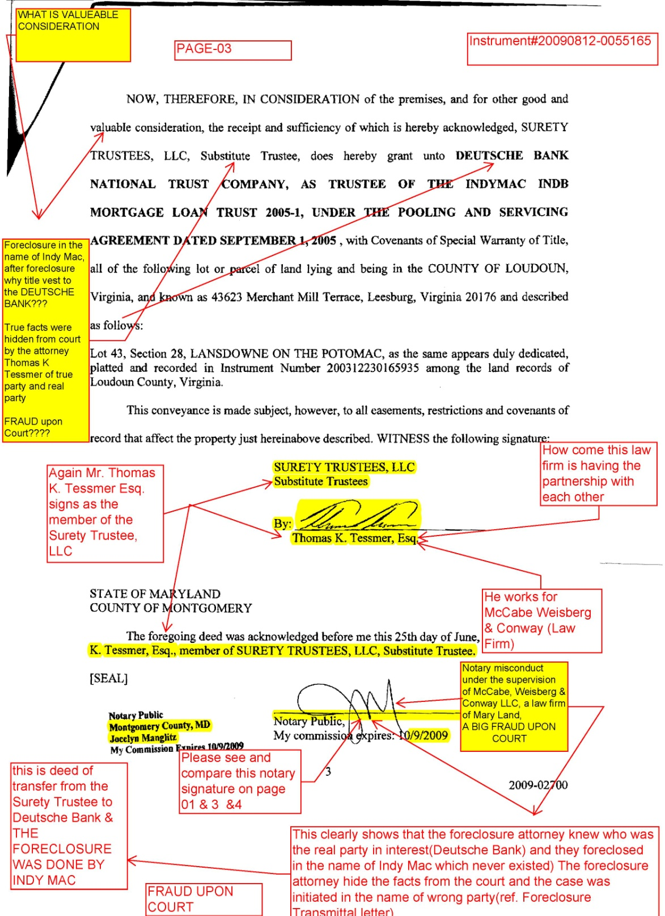
Instrument#20090612-0055165
Recorded in Loudoun County L/R
1.Here same Notary with different signature
2 Another attorney Thomas K. Tessmer involved in signing as member of Surety Trustee
3. Again here the F/Closure was initiated in the name of Indy Mac and after F/Closure Title Vest to Deutsche Bank (Undisclosed)???
4. Fraud upon Court, Borrower
5. True Facts were hidden From Court by the Attorney
6. Same Law Firm involved
7. A Big Transfer of Wealth
8. What we can expect from ?????

Slide 5
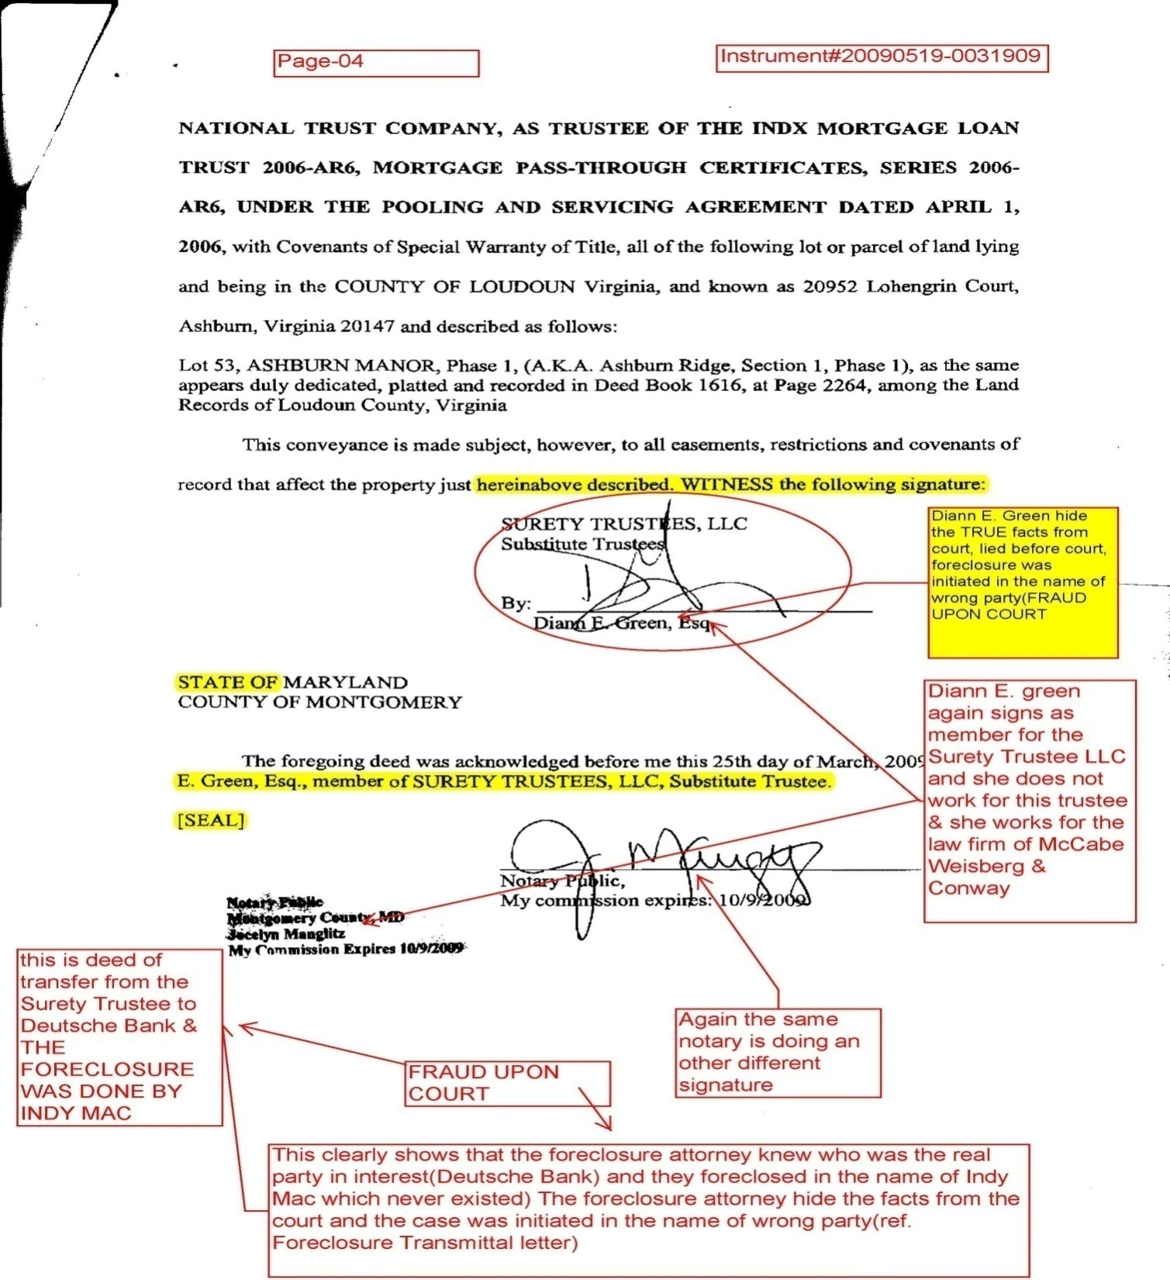
Instrument# 20090519-0031909
Recorded in Loudoun County L/R
By McCabe, Weisberg & Conway LLC
Indy Mac (servicer, already sold Note in Securitization)
Deutsche Bank (Undisclosed)
Ms. Diann E. Green did not state True Facts Before Court (Fraud Upon Court and Borrower)
Again Notary Signature are not same and F/Closure Attorney Knows???
Same Notary is used in all documents???
Attorney signing for Surety Trustee LLC, as member???
Fraud Closure

Slide 6
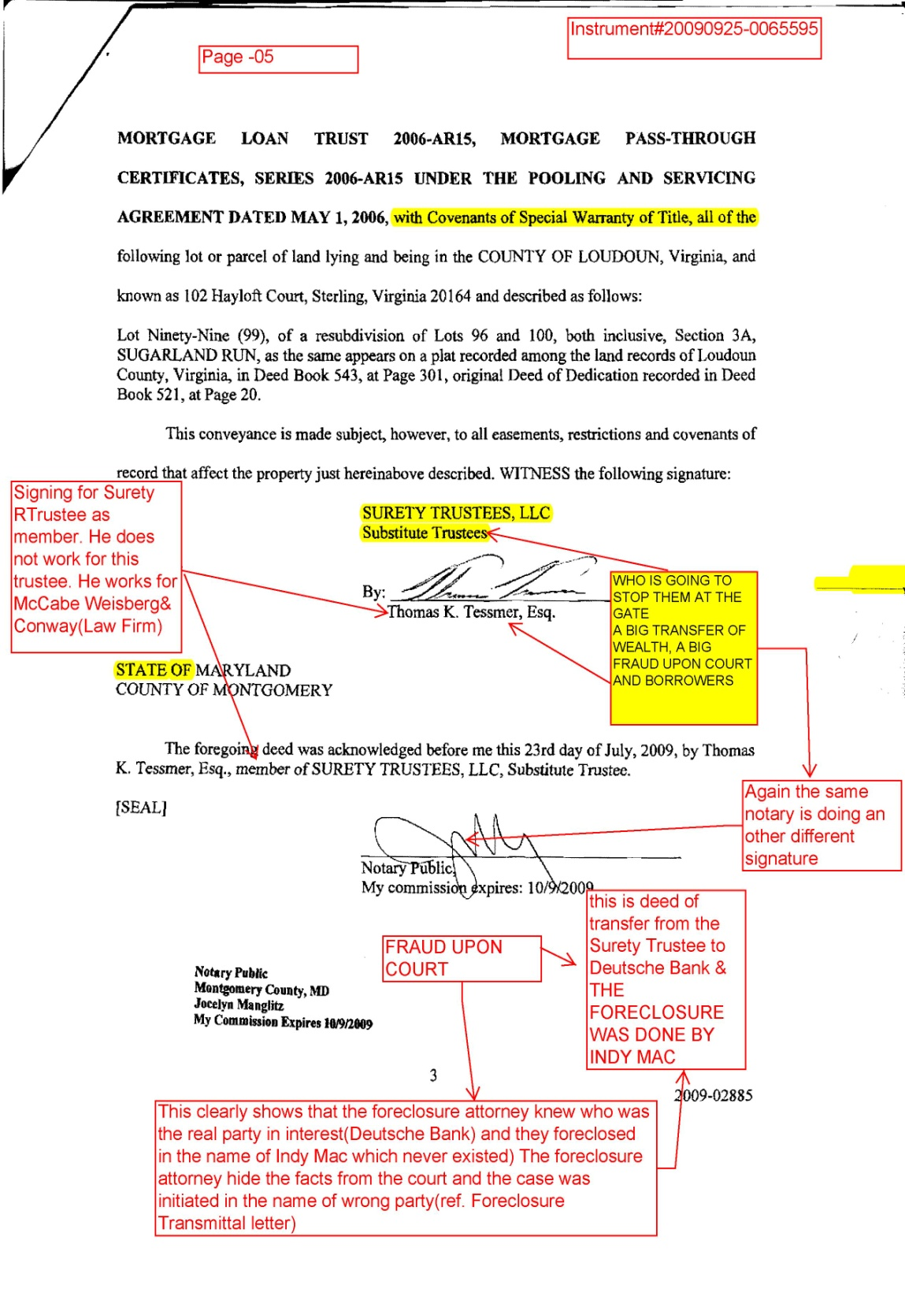
MORE INSTRUMENT
Recorded in The Loudoun County Land Record
Same Fraud is Repeated by the law Firm Of McCabe, Weisberg & Conway LLC
Same Notary with different signatures
Attorney Thomas K. Tessmer
Indy Mac/ Deutsche Bank involved

Slide 7
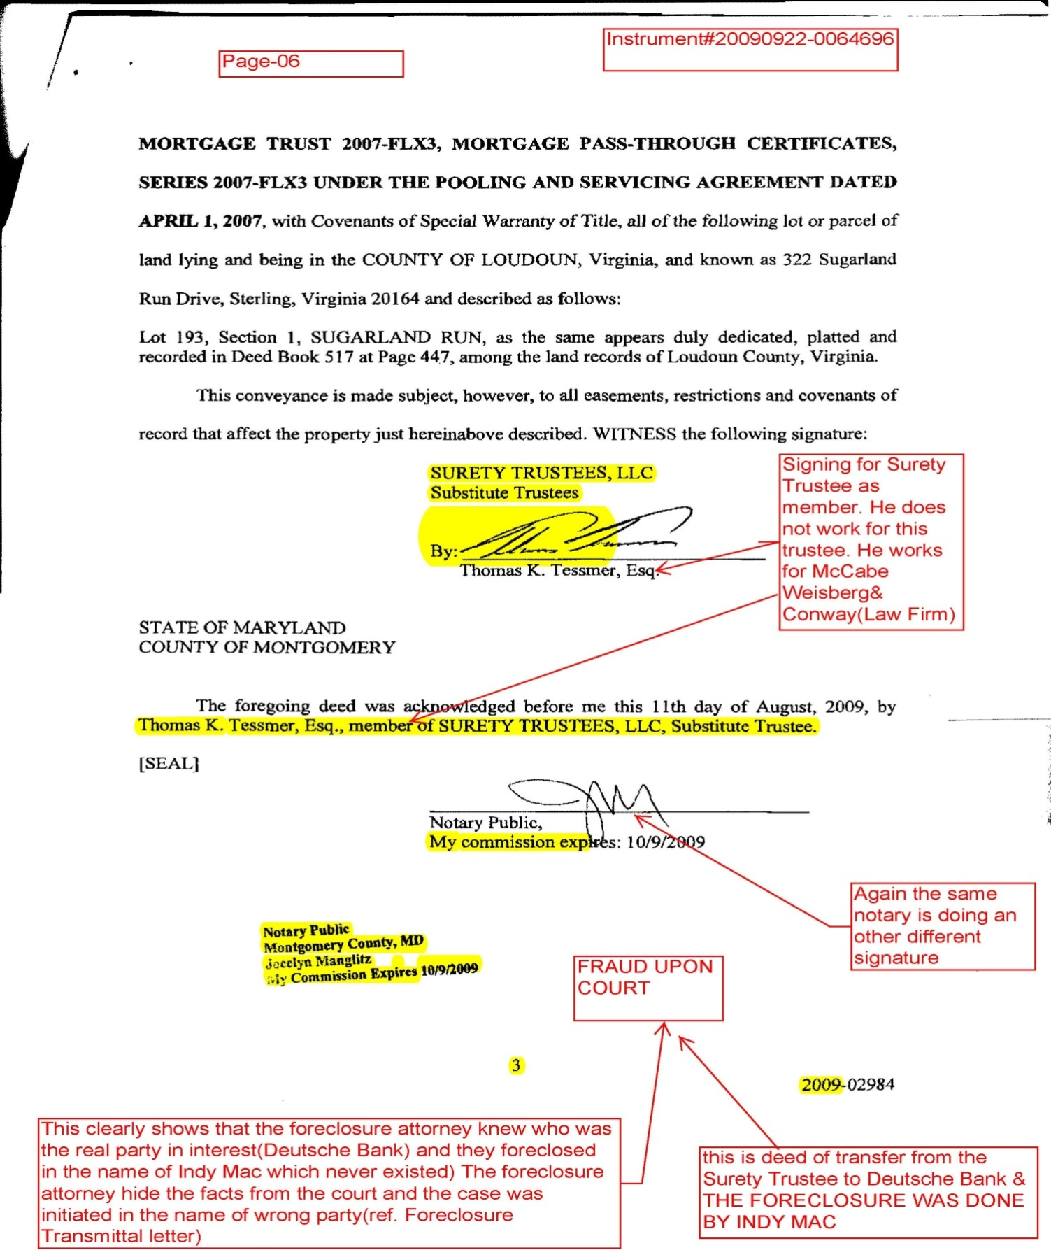
FRAUD UPON FRAUD BY
McCabe Weisberg & Conway LLC
Instrument#20090922-0064696
Instrument Recorded in Loudoun County
Attorney Mr. Thomas K. Tessmer
Notary same but signatures are different???
Indy Mac (Servicer)
Deutsche Bank (Undisclosed)
True Facts not stated before Court (Fraud)
FRAUD CLOSURE
By Law Firm????

Slide 8
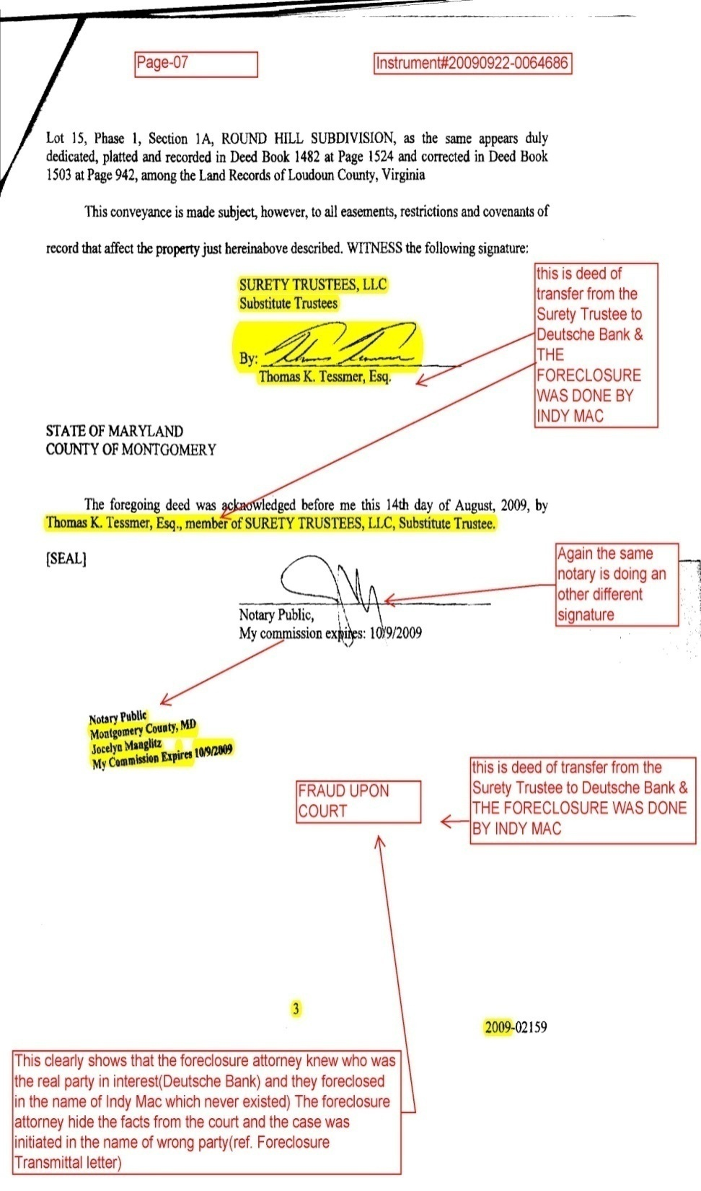
MORE FRAUDS
Instrument#20090922-0064686 recorded in Loudoun County Land Records By the Law firm (McCabe Weisberg & Conway LLC)
Attorney Thomas K. Tessmer
Same Notary with different Signature
Notary Misconduct
Indy Mac (servicer)
Deutsch Bank (UNDISCLOSED)
Wrong Foreclosure
Falsification Before Court (in writing)
Every thing is done by and under supervision of Law Firm
A BIG TRANSFER OF WEALTH

Slide 9
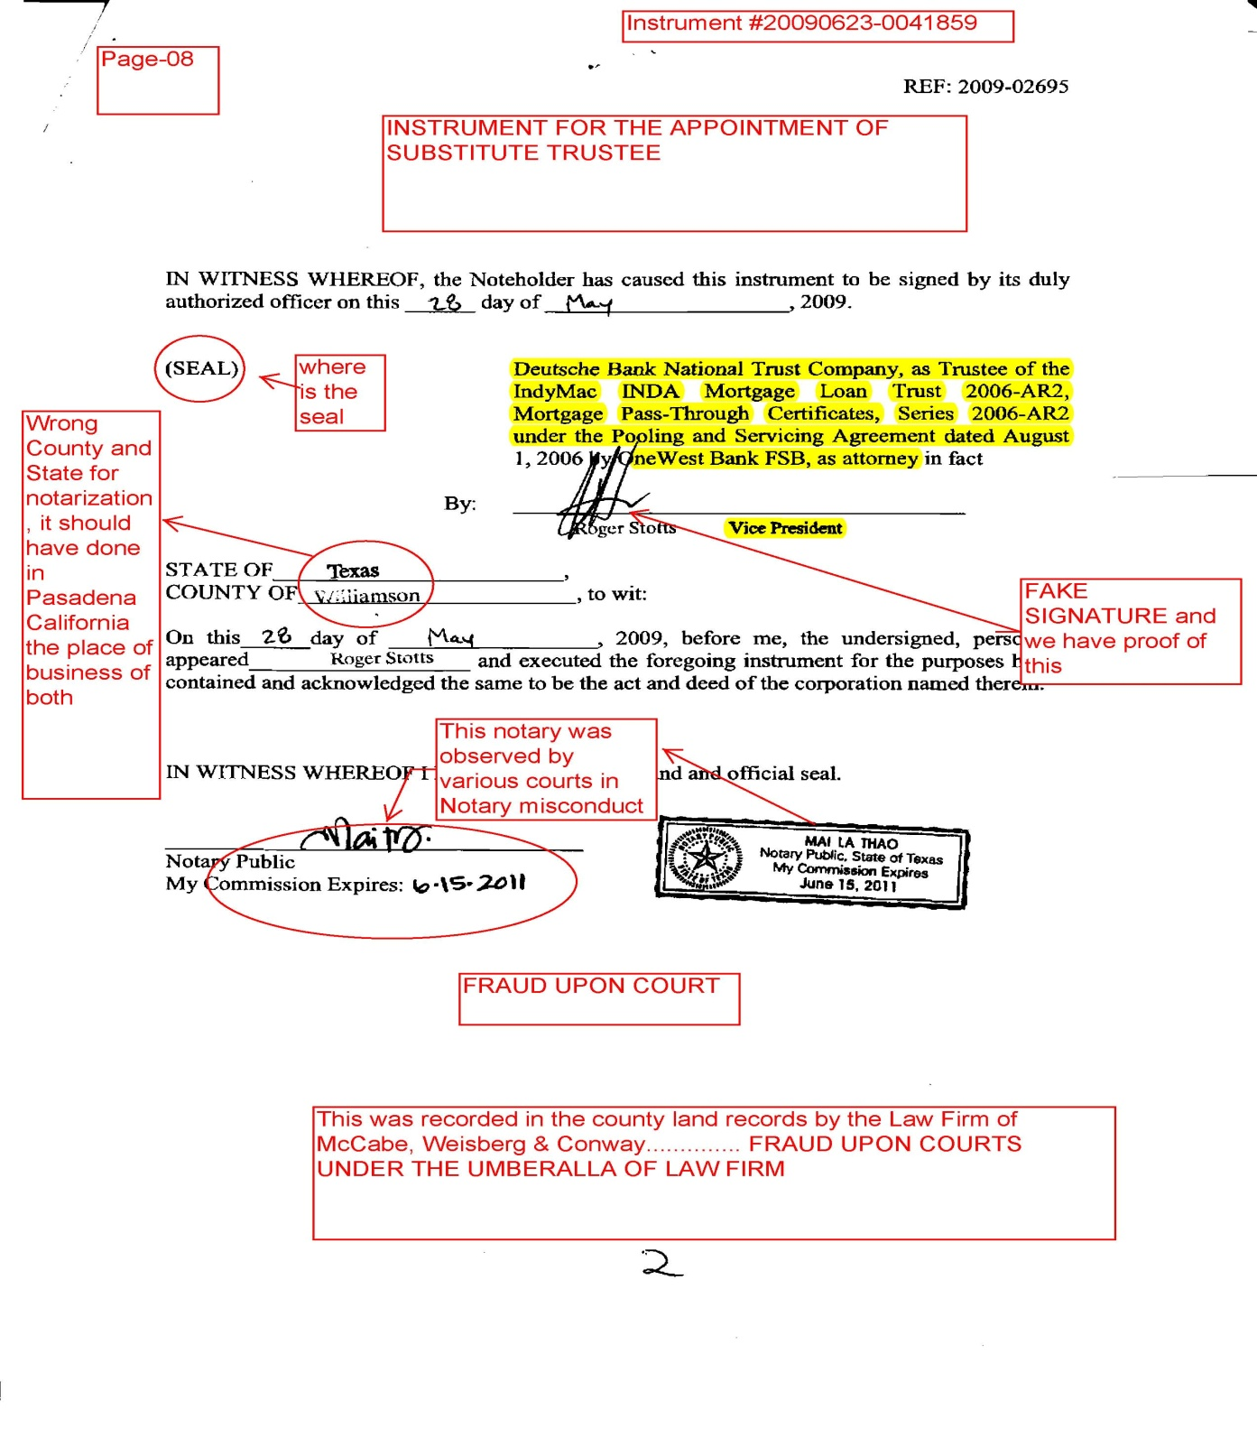
Great JOB McCabe, Weisberg & Conway, LLC
Instrument#20090623-0041859 for appointment of Substitute Trustee, LLC
One West FSB, V/President Mr. Roger Scott with Fake Signatures
This Notary was caught by Various Courts in Notary Misconduct
No Seal
Wrong State and County for Notarization, it should have been done in California, Pasadena the business place of OWB&DB

Slide 10
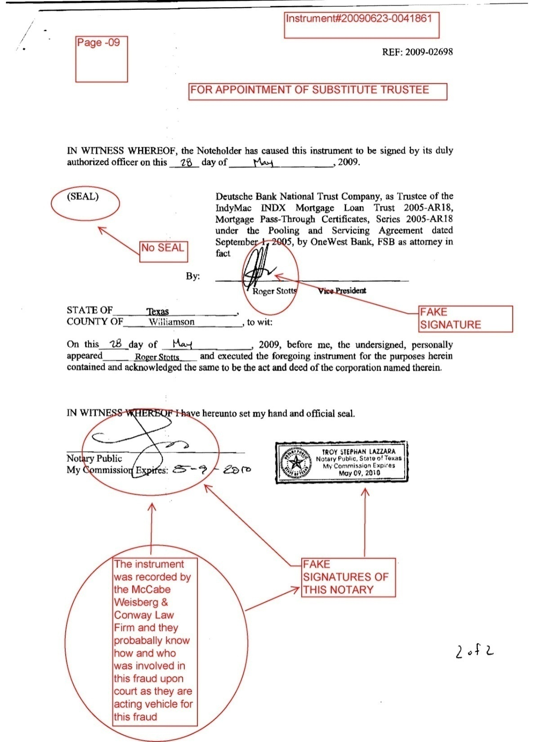
Another Fraud
Instrument#20090623-00411861
Recoded in Loudoun County L/R by the McCabe Weisberg& Conway LLC
V/P Mr. Roger Scott with Fake Signatures
This Notary signed in the Plaintiff’s
Case in a different way
This Notary was caught by Various Courts for Notary Misconduct
Again Notarization place is wrong
No Bank Seal????
No Witness????
Big Transfer of Wealth

Slide 11
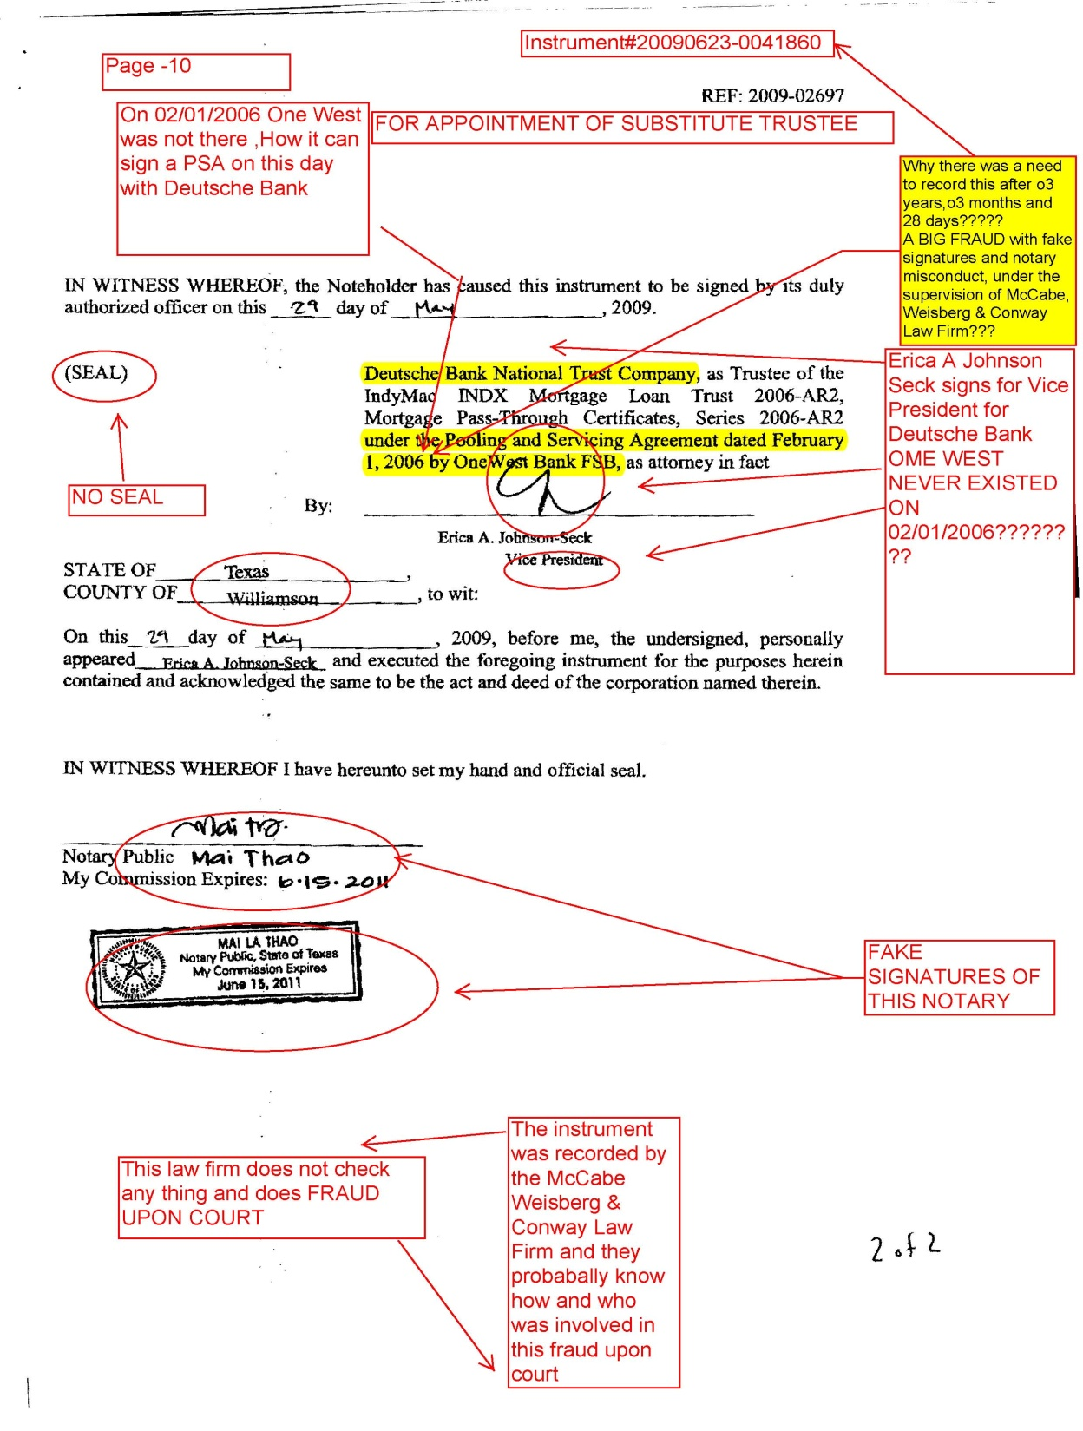
Instrument#20090623-0041860 recorded by
McCabe, Weisberg & Conway LLC in Loudoun County Land /R
V/P Erica A Johnson Seck
Caught by Various Courts
Wearing Various Hats for various Financial Institutions
Courts Disbelieve her Testimony
Court ordered her to give affidavit for her employment History (She never honored)
This Notary was also caught by various courts for notary misconduct
Wrong County& State for Notarization

Slide 12
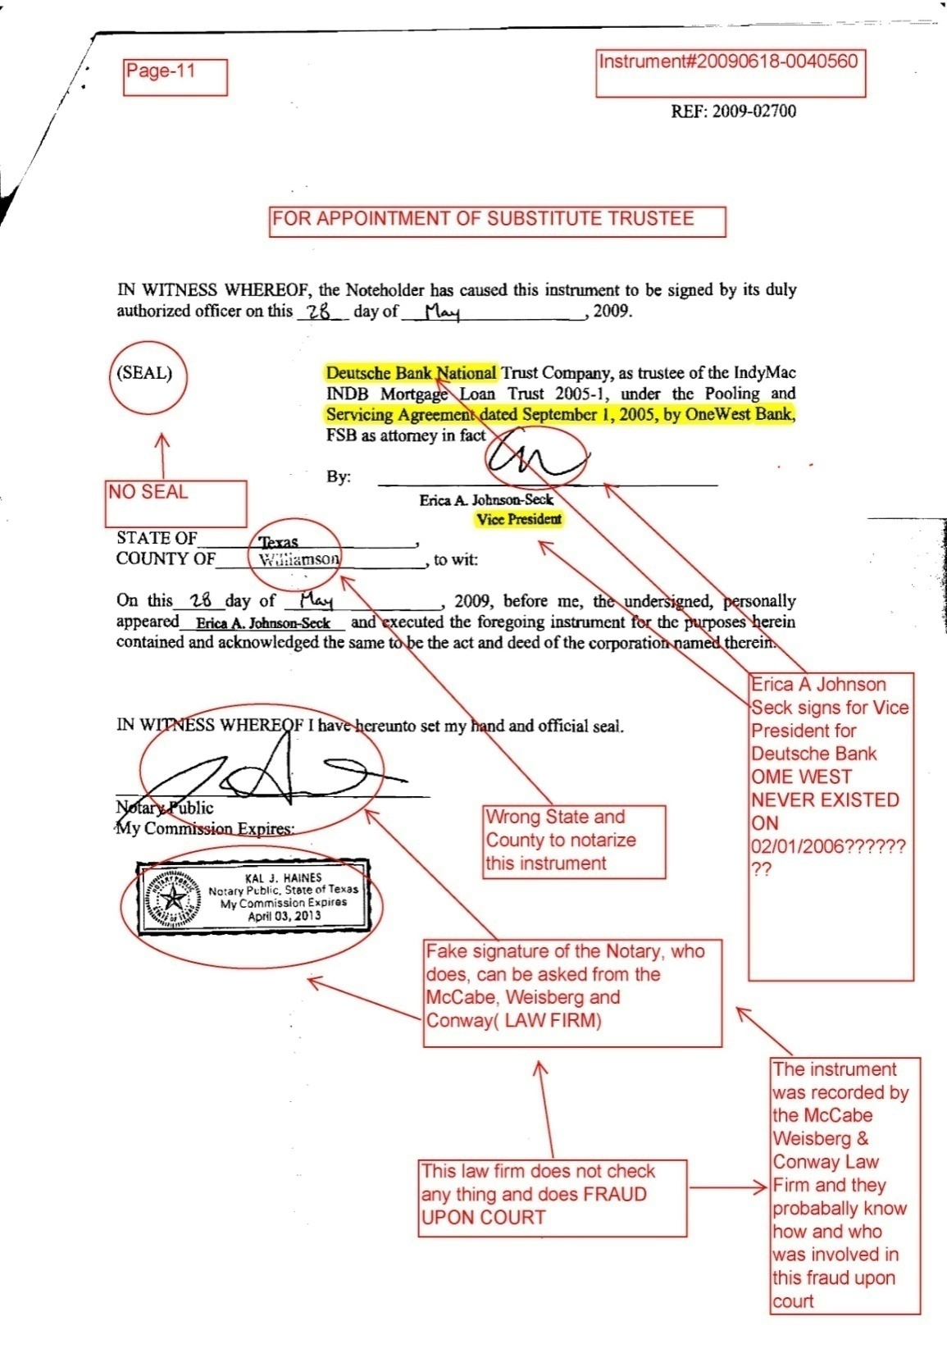
Instrument#20090618-0040560
Recorded in Loudoun County by the Same law Firm
V/P Erica A Johnson Seck
Caught by Various Courts
Wearing Various Hats for various Financial Institutions
Courts Disbelieve her Testimony
Court ordered her to give affidavit for her employment History (She never honored)
This Notary was also caught by various courts for notary misconduct
Wrong County& State for Notarization
Law Firm of McCabe, Weisberg & Conway does not check and doing FRAUD Upon FRAUD???????

Slide 13
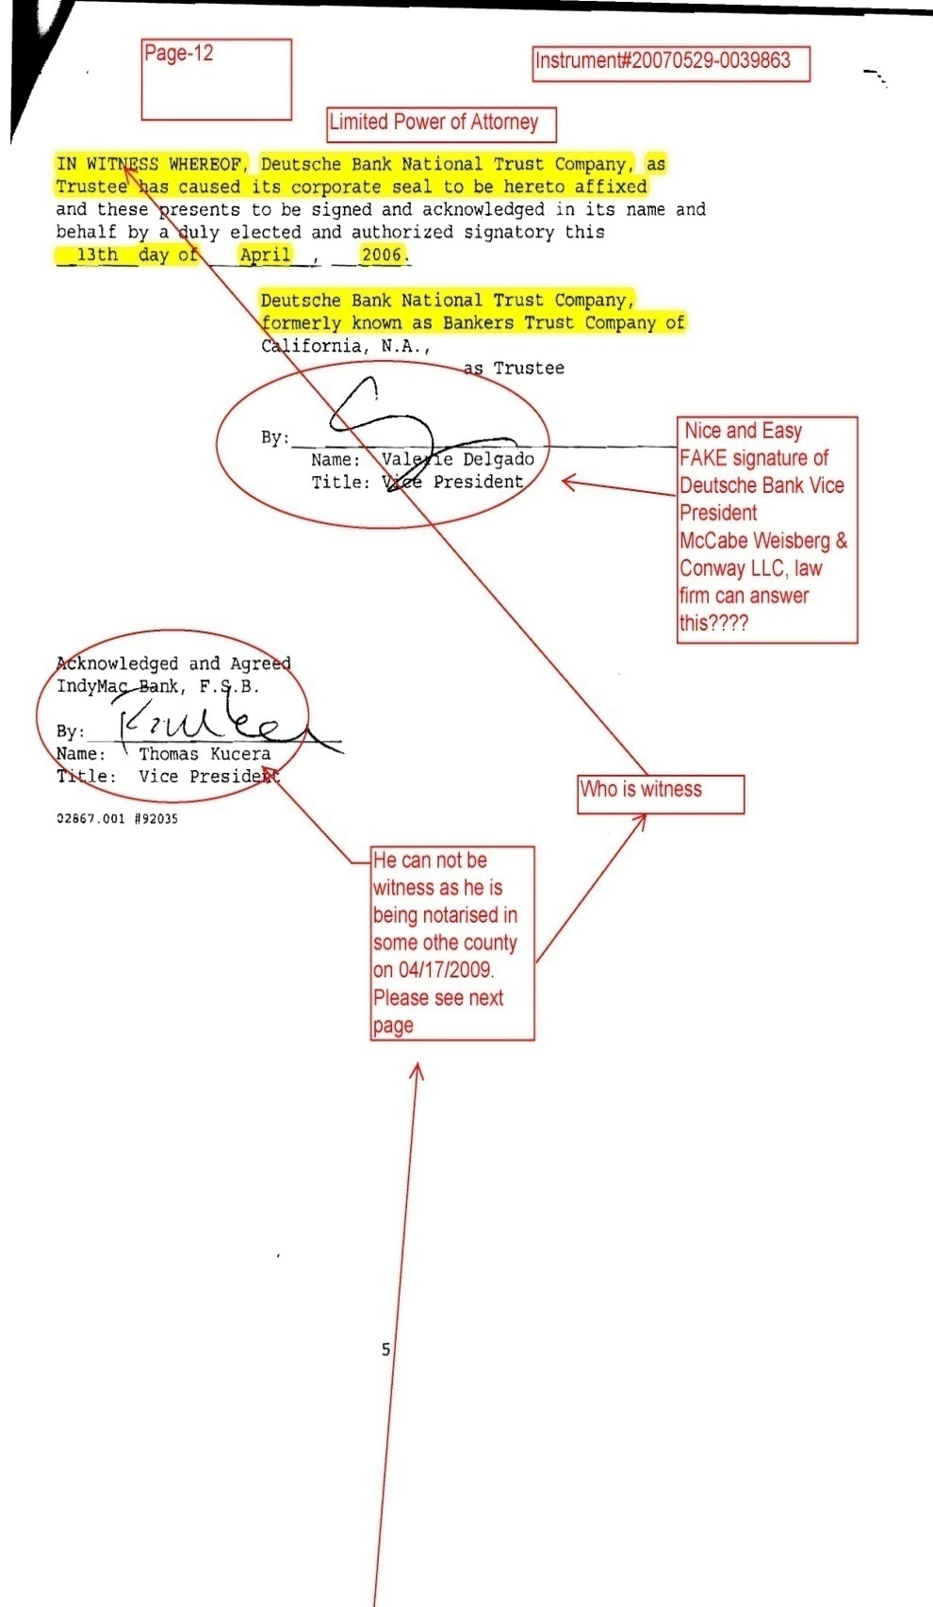
Instrument#20070529-0039863
Recorded in Loudoun County L/R
By McCabe Weisberg & Conway
LPOA
Fake Signatures
No Notarization?????
No Witness
ABIG FRAUD & BIG TRANSFER OF WEALTH

Slide 14
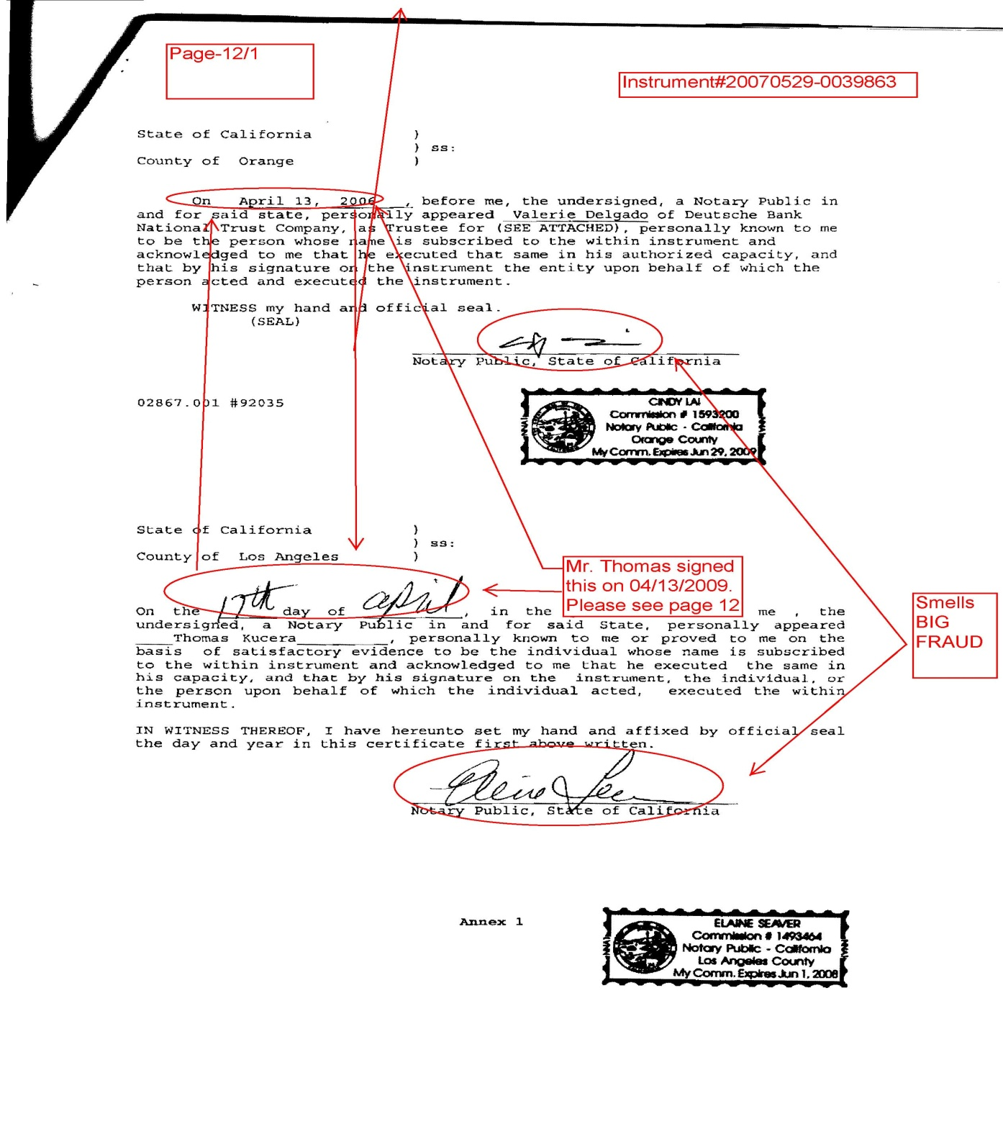
Instrument#20070529-0039863
Same Law Firm
Different dates
Two Notary but Different dates
No witness
No Signatures of Mr. Thomas Kucera but he is still Notaries as he appears without signature
FRAUD,FRAUD??????????????

Slide 15
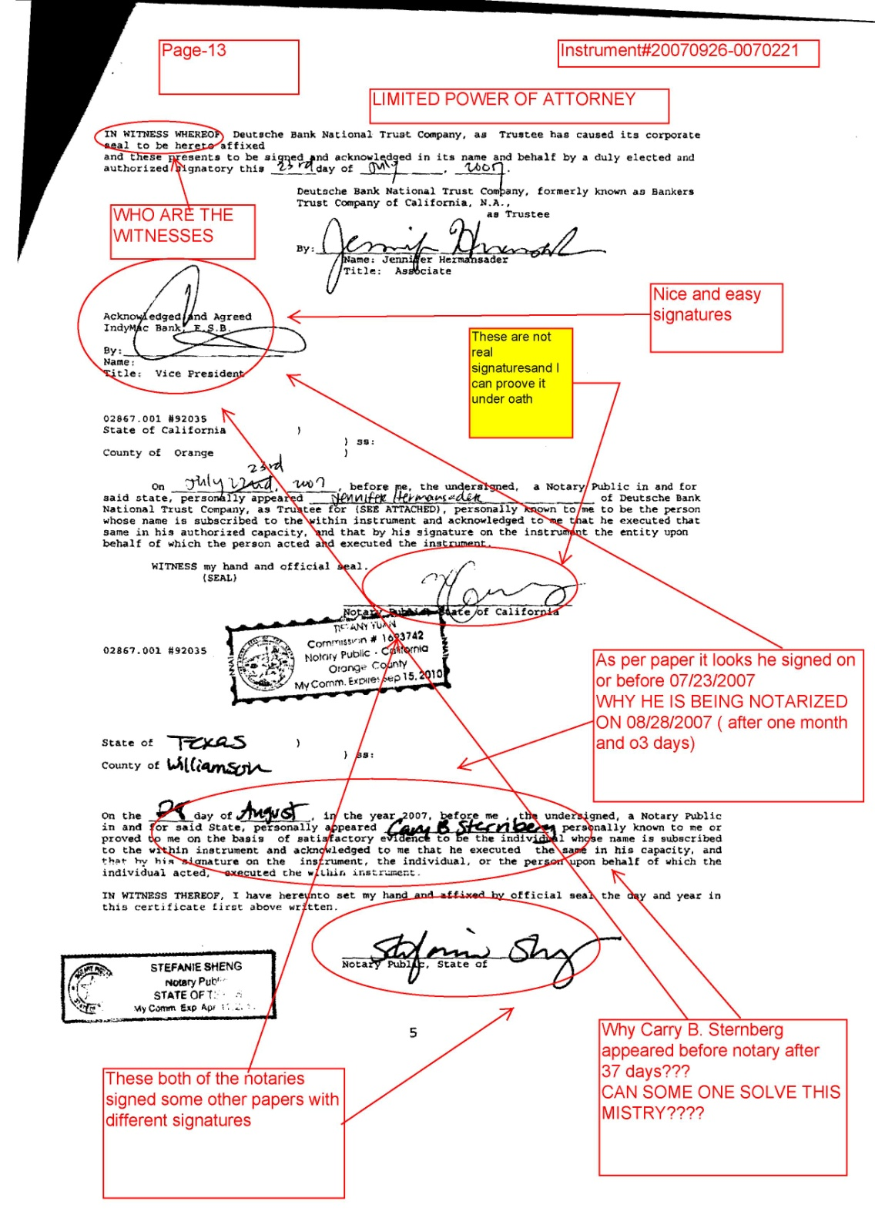
Instrument#20070926-0070221 Recorded in Loudoun County by same Law Firm
Every thing Fake
Notary Misconduct
Different dates
37 days different????
FRAUD UPON FRAUD
Can Some One Stop Them At The GATE????
WHO?????

Slide 16
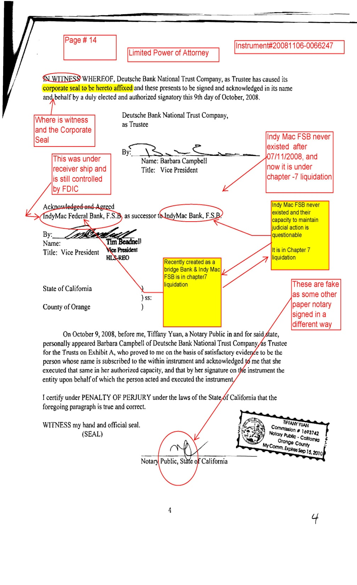
Instrument#20081104-0066247
Recorded in Loudoun County
Fake Signature
Notary Misconduct
Indy Mac FSB not existed on this day
Indy Mac Federal Bank was and still is in receivership of FDIC
FRAUD??????

