Slide 1
Legal 101
Real world legal remedy.

Slide 2
Life Is Not A Movie
In school, on television and in the movies, people are led to believe we live in a land of law, if you are in the right, law will work in your favor.
Good luck with that.
Perhaps, in a perfect world pure justice might be the case, however, if this were a perfect world I certainly would not be here and I have my doubts about you.
In spite of all the certainty and exactitude of statutes, rules and regulations, in the end, enforcement rests with human beings and where humans tread, politics precedes.

Slide 3
The Crap We Learned In High School
Here we will speak to some common fallacies about law we encouraged to accept by a lot of high school teachers who simply didn’t know better.
Disclaimer:
You will notice that we assume there are no bad guys. There may be a couple, but we find it more effective to act as if everyone does the best they can, given their perspective, personal, and professional limitations.

Slide 4
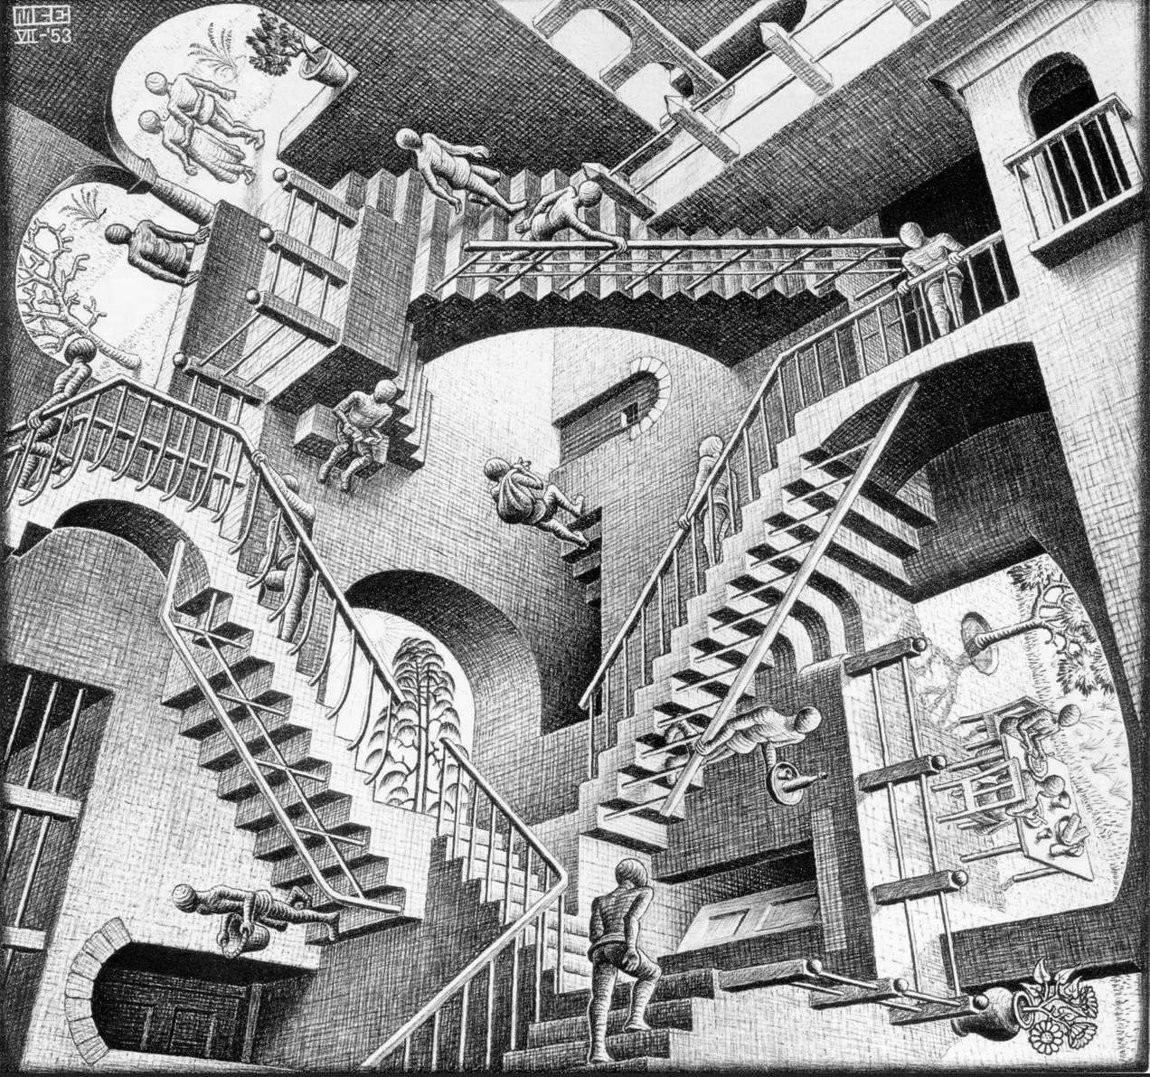
Life is not all ambiguity.
It looks worse from the outside. Once you begin to grasp the inner working of the system, things begin to organize themselves and order will begin to emerge from the seeming chaos.
There are guiding principals and we will attempt to acquaint you with them.

Slide 5
A Few Common Fallacies
The Constitution Grants you Inalienable rights.
The system is just and fair.
You will win if you have the law and facts on your side.
Your lawyer is on your side.
English is spoken in court.

Slide 6
Mental Flow
Never use acronyms (NYA).
Avoid pronouns, indefinite or otherwise.
Never make a proactive statement of law out of your own mouth.
Never create a question in the mind of your reader without answering it.
Always write to a 13 yearold.
Alliteration, rhyme, and meter.
Conversational ellipsis.
Artful vagueness
Style matters.

Slide 7
How to Think About Courts
Perry Mason Doesn’t Live Here
Any More

Slide 8
What They Don’t Teach in Law School
Lawyering is all about the money
  The lawyer is a salesperson first.
  The retainer is the is the prize.
  Why they dump you.
    Court is always a crap shoot.
    Legal Research is Dangerous and Costly

Slide 9
The Ugly Truth
The Actual Practice is Learned in the Trenches
  All Their Snouts are in the Same Trough
  It is all about relationships
Judges are Capricious
  Terror of Sanctions
  Retaliation as a Fact of Life

Slide 10
The Police State of America
How the American Courts became a street gang.

Slide 11
The Police State of America
How the American courts became a street gang.

Slide 12
Everything is Wrong
Some disturbing stats.
Courts cannot self govern.
Hey, lets let the lawyers do it.
Everyone acts in self interest.
Entropy rules the day.

Slide 13
Kens Four Rules
Everything is Political
  All politics is local
  Facts don’t matter
Perception is Everything
Everything is Negotiable
Document Document Document

Slide 14
Power of the Pro Se
You are the master of the governmental instruments you have created.

Slide 15
Masters of the Servants
Posture and Position
  Genus of our Founders
  There are no bad guys.
  Virtue of Discipline
Rights v Duties
  Limits of Authority
  Misconduct, official or otherwise

Slide 16
The System Can Not Fix Itself
Government is a machine with faulty parts.
Citizen are the mechanics.
One powerful toolbox.
  Laws, Rules, and Regulations
  Grandeur of Juries
When sheeple sleep.

Slide 17
The Routine
  Set them Up
    Give them opportunity to screw up.
    Never ask a public official for what you want.
    Never give fair warning, bush whack is better.
    The Chicken Dance
    Take them from bottom to top.
  Limits of scope.

Slide 18
How to Handle Your Lawyer
  It is all about relationships. (4sided Chessboard)
  Plausible Deniability
  Their weak underbelly
  They need your help to win
  Court appointed counsel conundrum

Slide 19
Preparation
Read the codes., twice.
Do your homework.
  Litigation Guides
  Briefs and Treatises
  Plagiarism as an Artform

Slide 20
You Never Win In Trial Court
Limited purpose of the trial court.
Facts and Law
  Timeline
  Hard Questions
  Write a novel
  Claims and cause of action
It is all elemental

Slide 21
How To Write Legal Documents
A Methodic Approach to Complex Document Construction

Slide 22
Ya Gotta Start Somewhere
Complaints v Complaining
Keeping thing Civil
  Tortious Behaviors
  Causes to Action

Slide 23
How To Think About
What You Are Thinking About
Cumulative Construction
Mental Flow
Read the Rules

Slide 24
Putting Pieces in Place
Timeline
  Just what happened and when
  Each on separate numbered line.
Write your novel and leave nothing out.
  Heading on every paragraph
  Stay within the headings
Extract causes and claims
  Use O’Connors Causes of Action
  Develop argument in support

Slide 25
Points and Authorities
  Convert your novel into a set of arguments in support
  Develop facts and law
Statement of Facts
  From the Points and Authorities extract elemental facts
  This part is an art form.
Conclusion
  Sum up the claims you will bring.
  Tell them what you told them
  Avoid argument here
Introduction
  Tell them what you are going to tell them
  This amounts to a summary of conclusions from facts

